Slide 1
Lecture 4 Parameteric Regression
Abrar Hasan
Lecturer
Dept. of Software Engineering

Slide 2
1
Parametric Regression
<
T
1
>

Slide 3
Parametric Regression
<
T
1
>
Parametric regression is a type of regression analysis where we assume that the relationship between the independent variables (predictors) and the dependent variable (target) can be modeled by a specific functional form, typically characterized by a finite set of parameters.

Slide 4
Parametric Regression
<
T
1
>
r = f (x)
e.g, r = mX + c
This can be written as
r = θ * X + c

Slide 5
Parametric Regression
<
T
1
>
θ * X + c Can be written as g(x| θ)

Slide 6
Parametric Regression
<
T
1
>
r = f (x) + ϵ
If we assume the noise to be gaussian, then we can model this Like a normal distribution with mean 0 with variance sigma²
ϵ ∼ N (0, σ²)

Slide 7
Parametric Regression
<
T
1
>
So the probability of Getting r from input X is
p(r∣x) ∼ N (g(x∣θ), σ²)

Slide 8
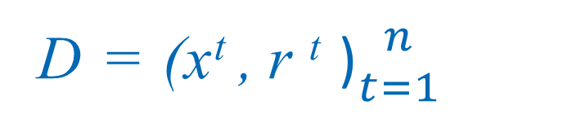
Parametric Regression
<
T
1
>
Suppose we have a data set D. In dataset there is independent x, and dependent r
D = (x^{t} , r ^{t} )${n \atop t=1}$
X₁ | R₁
X₂ | R₂
X₃ | R₃
X₄ | R₄
X₅ | R₅

Slide 9
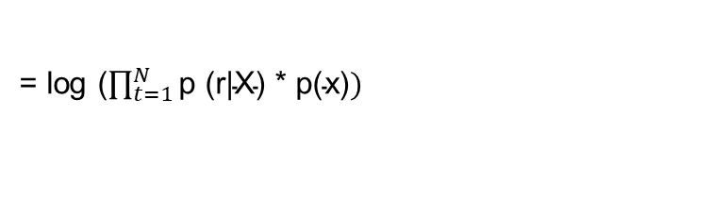
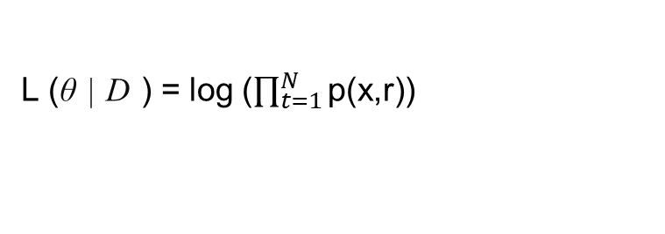
Parametric Regression
<
T
1
>
We Know Joint Probability is P(x,r). Probability occurring the x and r together.
p(x,r) = p (r|X) * p(x)
So, Log Likelihood is (Predicting the θ for our dataset D )
L (θ | D ) = log ($\prod_{t=1}^{N}{\text{p}\text{(}\text{x}\text{,}\text{r}\text{)) }}$
= log ($\prod_{t=1}^{N}{\text{p}\text{ (}\text{r}\text{|}\text{X}\text{) * }\text{p}\text{(}\text{x}\text{)})}$

Slide 10
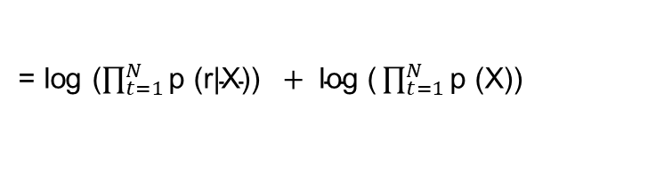
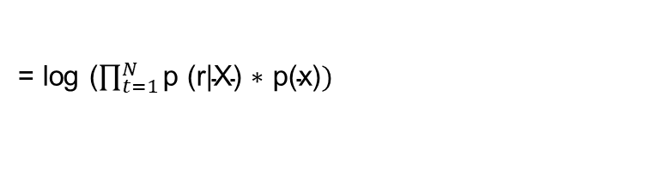

Parametric Regression
<
T
1
>
L (θ | D ) = log ($\prod_{t=1}^{N}{\text{p}\text{(}\text{x}\text{,}\text{r}\text{)) }}$
= log ($\prod_{t=1}^{N}{\text{p}\text{ (}\text{r}\text{|}\text{X}\text{) ∗ }\text{p}\text{(}\text{x}\text{)})}$
= log ($\prod_{t=1}^{N}{\text{p}\text{ (}\text{r}\text{|}\text{X}\text{)) }} + \text{log}\text{ (}\prod_{t=1}^{N}{\text{p}\text{ (}\text{X}\text{)) }}$
But this term is constant

Slide 11
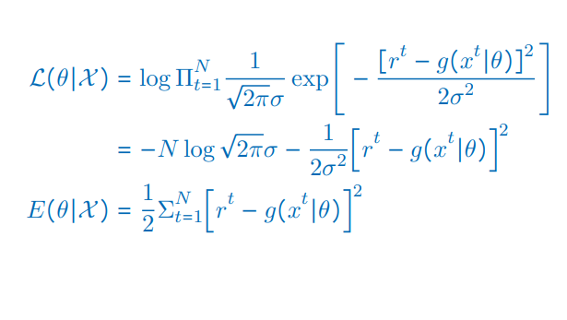


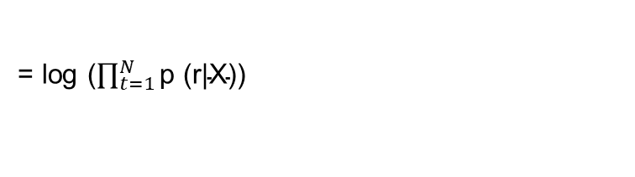
Parametric Regression
<
T
1
>
= log ($\prod_{t=1}^{N}{\text{p}\text{ (}\text{r}\text{|}\text{X}\text{)) }}$
$$We Know the Probability Function:$$
$\text{p}\text{ (}\text{r}\text{|}\text{X}\text{)}$ =

Slide 12

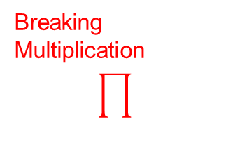
Parametric Regression
<
T
1
>
Breaking Multiplication
This is constant
So we have to minimize this

Slide 13
1
Linear Regression
<
T
1
>

Slide 14
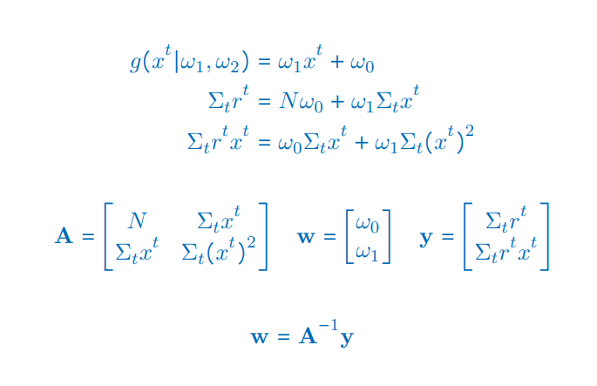
Linear Regression
<
T
1
>
BY differentiating with respect to w₁, w₀

Slide 15

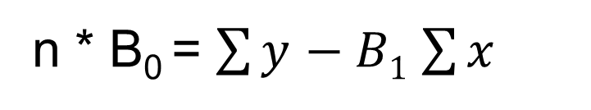
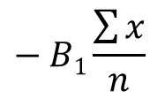
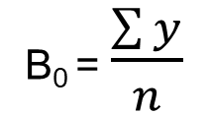
Linear Regression
<
T
1
>
BY differentiating with respect to w₁, w₀
B₀ = $\frac{\sum{y}}{n}$
$$− B1\frac{\sum{x}}{n}$$
n * B₀ = $\sum{y}$ $− B1$ $\sum{x}$

Slide 16
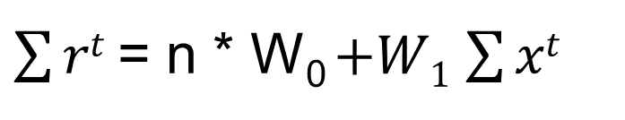
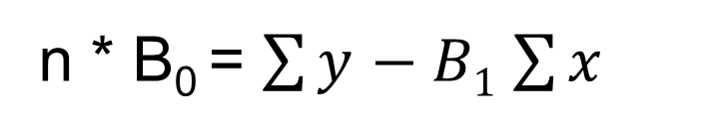
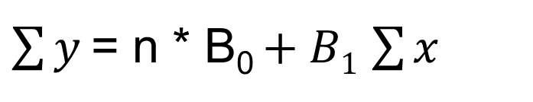
Linear Regression
<
T
1
>
n * B₀ = $\sum{y}$ $− B1$ $\sum{x}$
$\sum{y}$= n * B₀ $+ B1$ $\sum{x}$
$\sum{rt}$= n * W₀ $+W1$ $\sum{xt}$

Slide 17
Linear Regression
<
T
1
>
Y = A * W

Slide 18
Linear Regression
<
T
1
>
W = A⁻¹ * Y

Slide 19
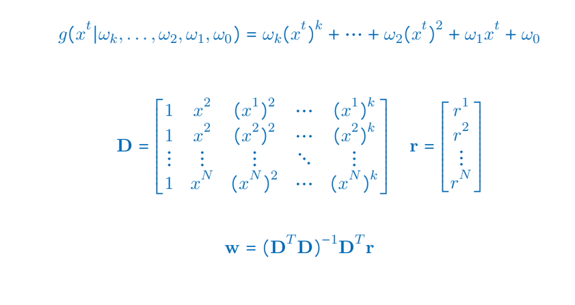
Polynomial Regression
<
T
1
>

Slide 20
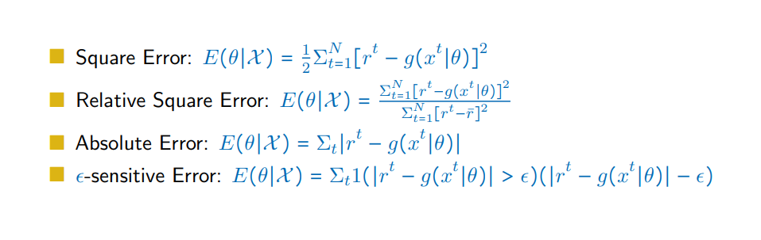
Error Measures
<
T
1
>

Slide 21
Linear Regression
<
T
1
>
Linear regression is a statistical technique used to model the relationship between a dependent variable (also called the target or response variable) and one or more independent variables (also called predictors or features)

Slide 22
Linear Regression
<
T
1
>
For example, you might want to predict a person's height (in inches) from his weight (in pounds).

Slide 23
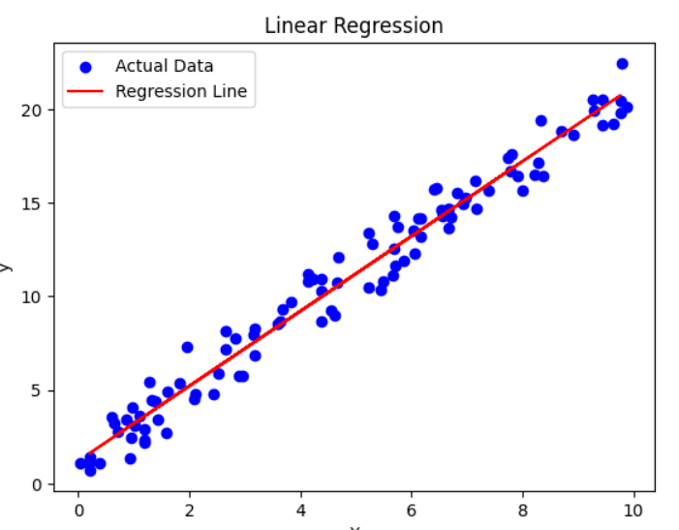
Linear Regression
<
T
1
>
y=β₀​+β₁​x+ϵ
Y = mX + C

Slide 24

Linear Regression
<
T
1
>
y=β₀​+β₁​x+ϵ
Y = mX + C

Slide 25
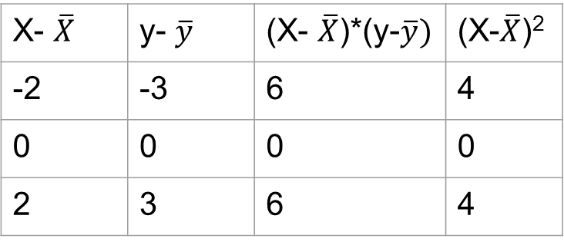


Linear Regression
<
T
1
>
Suppose You have to Build a linear regression model to predict the pizza prices from Following data
Pizza Size (x) | Pizza Price(y)
8 | 10
10 | 13
12 | 16
X- $\overline{X}$ | y- $\overline{y}$ | (X- $\overline{X}$)*(y-$\overline{y})$ | (X-$\overline{X}$)²
-2 | -3 | 6 | 4
0 | 0 | 0 | 0
2 | 3 | 6 | 4
$\overline{X}$ = $\frac{8+10+12}{3}$ = 10
$\overline{y}$ = $\frac{10+13+16}{3}$ = 13

Slide 26

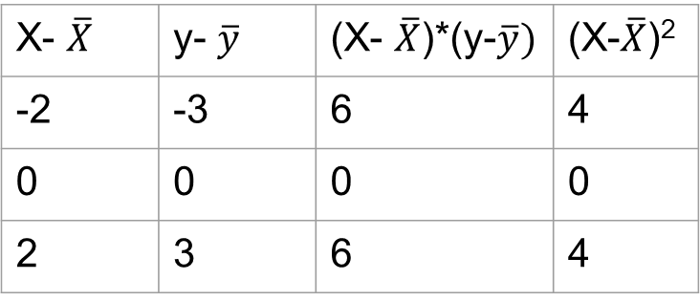

Linear Regression
<
T
1
>
Pizza Size (x) | Pizza Price(y)
8 | 10
10 | 13
12 | 16
X- $\overline{X}$ | y- $\overline{y}$ | (X- $\overline{X}$)*(y-$\overline{y})$ | (X-$\overline{X}$)²
-2 | -3 | 6 | 4
0 | 0 | 0 | 0
2 | 3 | 6 | 4
$=\frac{6+6}{4+4}=\frac{12}{8}=1.5$
$$=13 −\left(1.5 ∗10\right)=−2$$

Slide 27
Linear Regression
<
T
1
>
Y = 1.5X -2

Slide 28
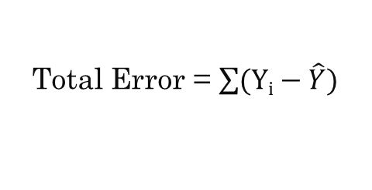


Linear Regression
<
T
1
>
Observed y-value
Real = Y
y
d₃
Predicted = $\hat{Y}$
d₁
d₂
Predicted y-value
Error d₁ = $Yi−\hat{Y}$
x
Total Error = $\sum{(Yi−\hat{Y})}$

Slide 29
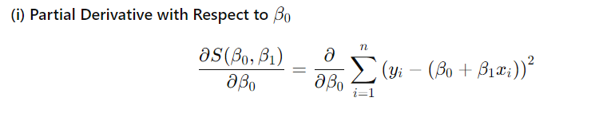
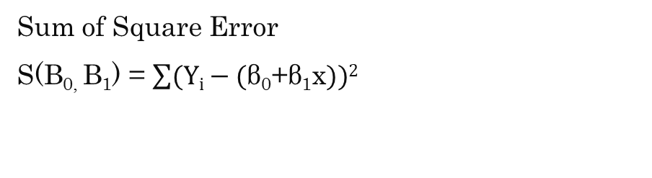
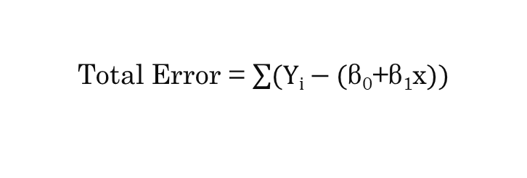
Linear Regression
<
T
1
>
Y = β₀​+β₁​x
Total Error = $\sum{(Yi−\text{(}\text{β}\text{0}\text{​+}\text{β}\text{1}\text{​}\text{x}))}$
Sum of Square Error
S(B_{0,} B₁) = $\sum{(Yi−\text{(}\text{β}\text{0}\text{​+}\text{β}\text{1}\text{​}\text{x}))2}$

Slide 30
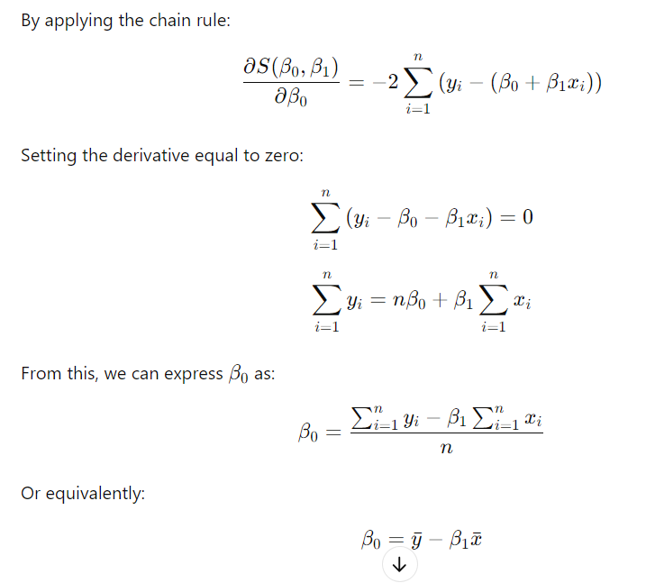
Linear Regression
<
T
1
>

Slide 31
Linear Regression
<
T
1
>

Slide 32
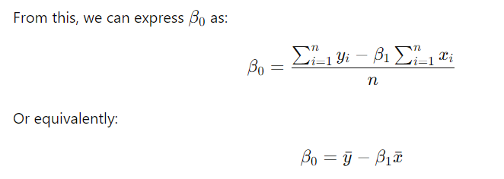
Linear Regression
<
T
1
>

Slide 33
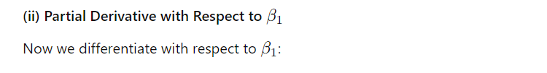
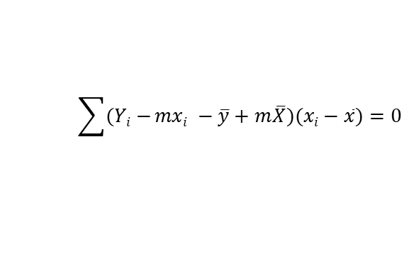
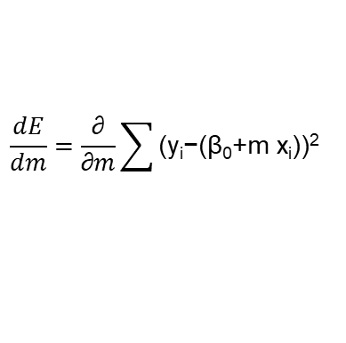
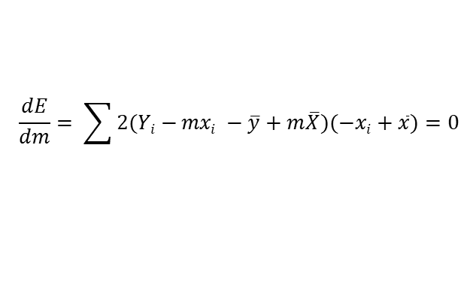
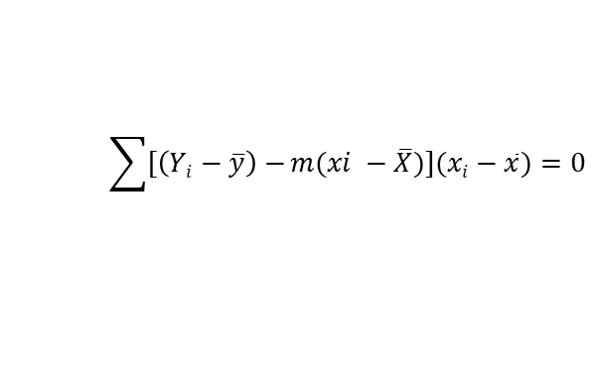
Linear Regression
<
T
1
>
$$\frac{dE}{dm}=\frac{\text{∂}}{\text{​∂}m}\sum{\text{(}\text{yi}\text{​−(}\text{β}\text{0}\text{​+}\text{m} \text{​}\text{x}\text{i}\text{​))}\text{2}}$$
$$\frac{dE}{dm}= \sum{2(Yi−}mxi −\overline{y}+m\overline{X})(−xi+\overline{x})=0$$
$$\sum{(Yi−}mxi −\overline{y}+m\overline{X})(xi−\overline{x})=0$$
$$\sum{[\left(Yi−\overline{y}\right)−}m(xi −\overline{X})](xi−\overline{x})=0$$

Slide 34
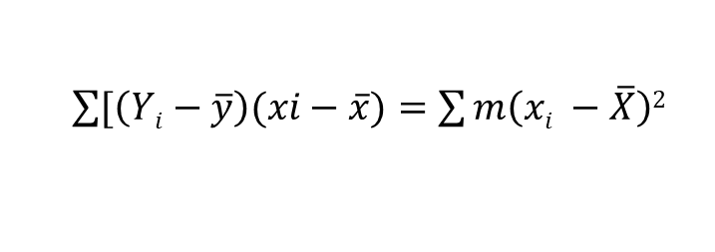
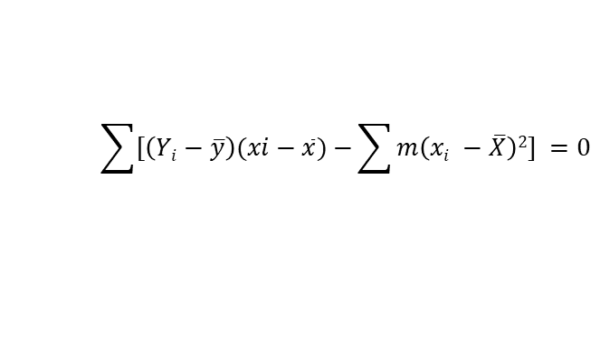
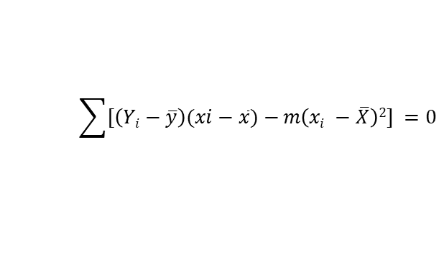
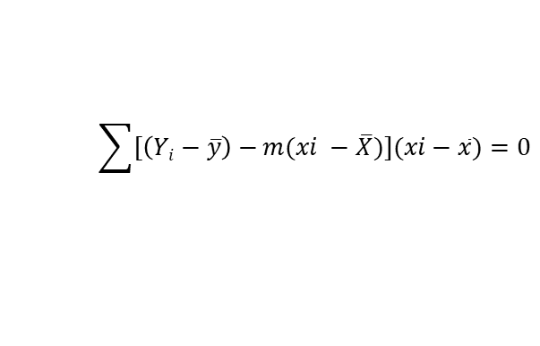

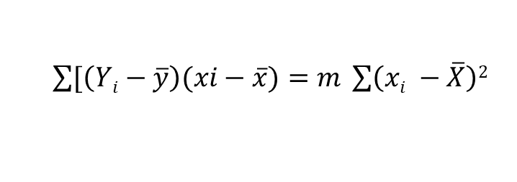
Linear Regression
<
T
1
>
$$\sum{[\left(Yi−\overline{y}\right)−}m(xi −\overline{X})](xi−\overline{x})=0$$
$$\sum{[\left(Yi−\overline{y}\right)(xi−\overline{x})−}m\left(xi −\overline{X}\right)2] =0$$
$$\sum{[\left(Yi−\overline{y}\right)(xi−\overline{x})−}\sum{m\left(xi −\overline{X}\right)2]} =0$$
$\sum{[\left(Yi−\overline{y}\right)(xi−\overline{x})}=$ $\sum{m\left(xi −\overline{X}\right)2}$
$\sum{[\left(Yi−\overline{y}\right)(xi−\overline{x})}=$ $m \sum{\left(xi −\overline{X}\right)2}$
$$m= \frac{\sum{[\left(Yi−\overline{y}\right)(xi−\overline{x})}}{\sum{\left(xi −\overline{X}\right)2}}$$

Slide 35
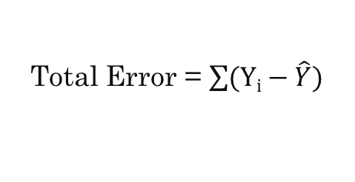
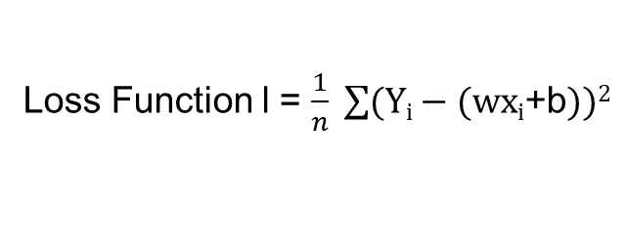
Gradient Descent
<
T
1
>
y = wx_{i} + b
Observed y-value
Total Error = $\sum{(Yi−\hat{Y})}$
y
d₃
Loss Function l = $\frac{1}{n} \sum{(Yi−\text{(}\text{wxi}\text{​+}\text{b}))2}$
d₁
d₂
Predicted y-value
x

Slide 36
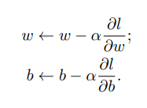
Gradient Descent
<
T
1
>
w ← 0 and b ← 0

Slide 37
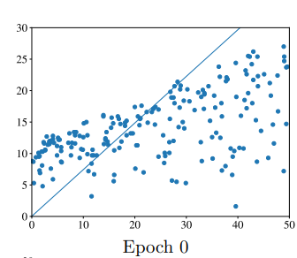
Gradient Descent
<
T
1
>

Slide 38
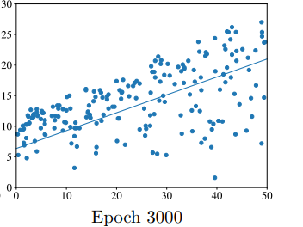
Gradient Descent
<
T
1
>

Slide 39
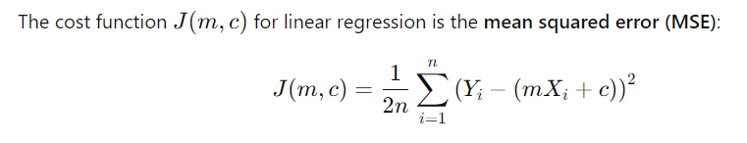
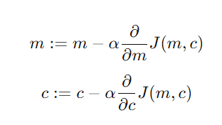
Gradient Descent
<
T
1
>

Slide 40
Gradient Descent
<
T
1
>
X | Y | Y(Predicted)
1 | 1 | 0
2 | 2 | 0
3 | 3 | 0
4 | 4 | 0
Y = mx + c
Let,
m =0
C= 0

Slide 41
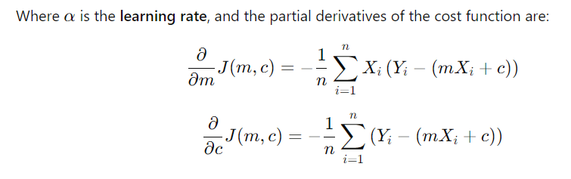

Gradient Descent
<
T
1
>

Slide 42
Gradient Descent
<
T
1
>

Slide 43
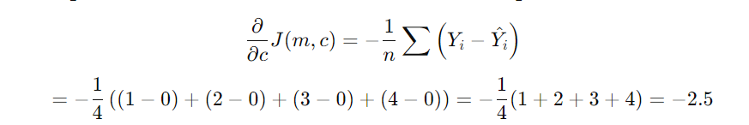
Gradient Descent
<
T
1
>

Slide 44
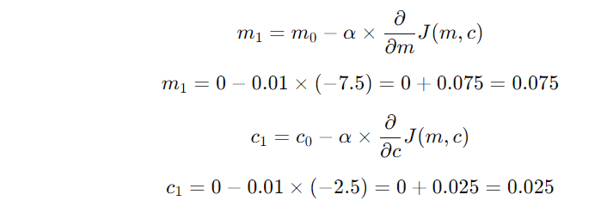
Gradient Descent
<
T
1
>

Slide 45
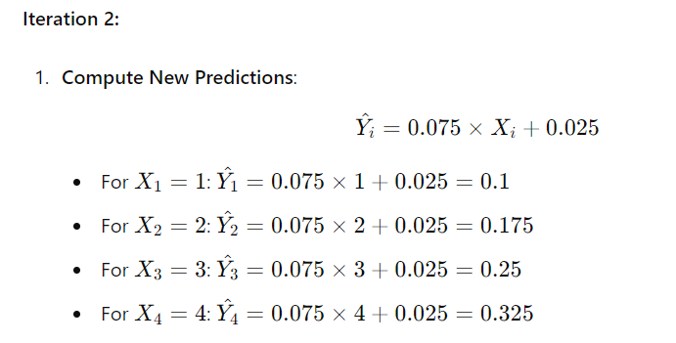
Gradient Descent
<
T
1
>

Slide 46
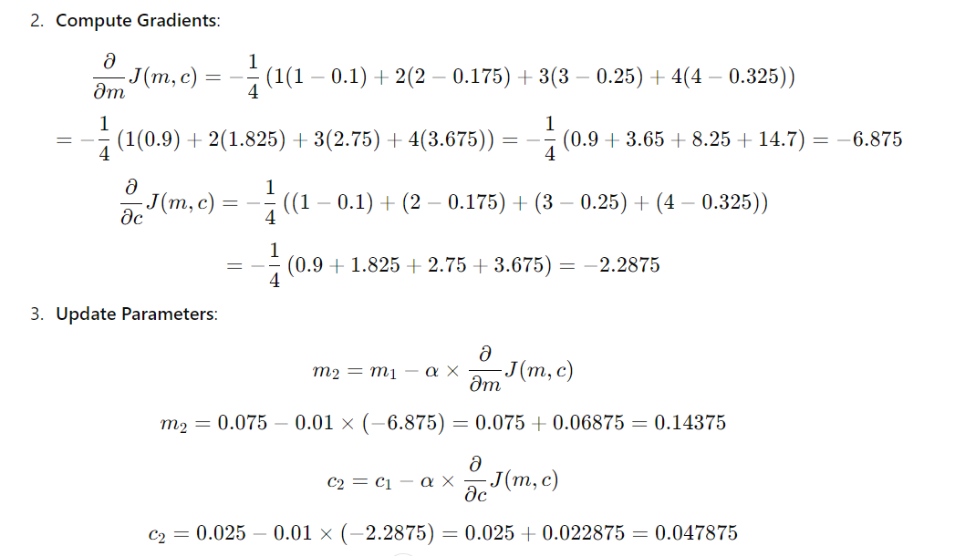
Gradient Descent
<
T
1
>

Slide 47
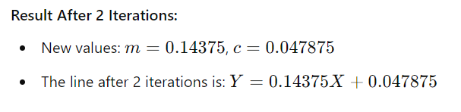
Gradient Descent
<
T
1
>

Slide 48
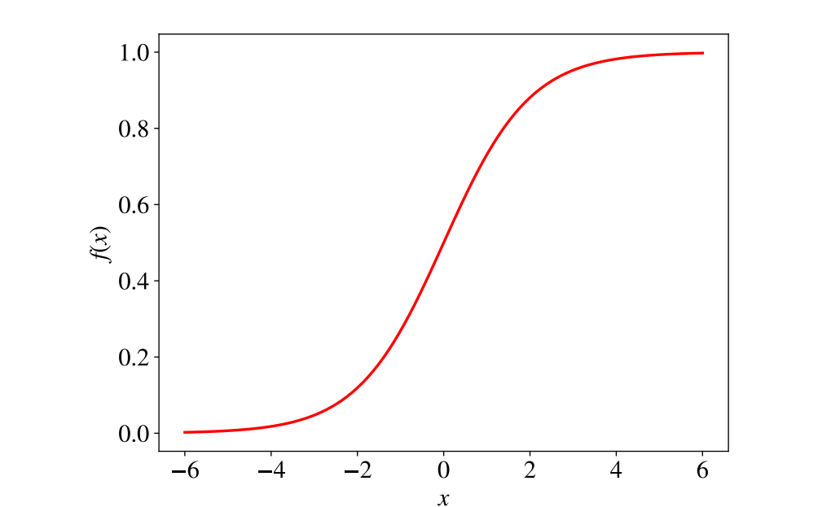


Logistic Regression
<
T
1
>
f(x) = $\frac{1}{1+e^{−x}}$
f(x) = $\frac{1}{1+e^{−(wx+b)}}$

Slide 49


Logistic Regression
<
T
1
>
f(x) = $\frac{1}{1+e^{−(wx+b)}}$

Slide 50

Logistic Regression
<
T
1
>

Slide 51
Logistic Regression
<
T
1
>

Slide 52

Logistic Regression
<
T
1
>

Slide 53
Logistic Regression
<
T
1
>
Hour Studied | Pass/ Fail | Y(Predicted)
2 | 0 | .5
3 | 0 | .5
5 | 1 | .5
7 | 1 | .5

Slide 54

Logistic Regression
<
T
1
>

Slide 55

Logistic Regression
<
T
1
>

Slide 56

Logistic Regression
<
T
1
>

Slide 57

Logistic Regression
<
T
1
>

Slide 58
Thank You

